Slide 1
To be or not to be a… Data Scientist
A Data Science Approach to Finding a Common Definition and Skillset
Andy Ho | An Nguyen | Jodi Pafford
Dr. Robert Slater
November 1, 2019
Notes:
Andy – Intro Slide

Slide 2

I am a Data Scientist
Education
BA in Economics w/minor in Computer Science
Occupation
Entrepreneur | Solutions Architect
Industry
Consumer Electronics
Insurance Technology
Andy Ho
Los Angeles, CA
Notes:
Team – Personal Intro

Slide 3
I am a Data Scientist
Education
BA in Fine Art
MA in Math Curriculum and Instruction
Occupation
Progress Monitoring and Innovation Manager
Industry
Education
Jodi Pafford
Aurora, CO
Notes:
Team – Personal Intro

Slide 4

I am a Data Scientist
Education
BS in Biology
MS in Biochemical Engineering
Occupation
Quality Control Analyst
Industry
Pharmaceuticals
An Nguyen
Ft. Worth, TX
Notes:
Team – Personal Intro

Slide 5
Are you a Data Scientist?
Clap your hands if you are…
Data Scientist
Not a Data Scientist
Not Sure

Slide 6
Statistician
Software Engineer
Data Scientist
Data Analyst
Data Engineer
Database Administrator
Notes:
Andy - Problem

Slide 7
Statistician
Software Engineer
Data Scientist
Data Analyst
Data Engineer
Database Administrator
Notes:
Andy - Problem

Slide 8
Why is this worth solving?
Employers
Level-set expectations
Assign appropriate compensation
Post jobs accurately
There is no UNICORN
Individuals
Level-set job market reality
Self-awareness
Build on strengths
Acknowledge weaknesses
Notes:
Andy - Problem

Slide 9
Why is this worth solving?
Employers
Level-set expectations
Assign appropriate compensation
Post jobs accurately
There is no UNICORN
Individuals
Level-set job market reality
Self-awareness
Build on strengths
Acknowledge weaknesses
Notes:
Andy - Problem

Slide 10
Common Definition
Notes:
Andy - Conclusion

Slide 11
Skill Sets Possessed by Data Scientist
Notes:
Andy - Conclusion

Slide 12
From Data Collection to Conclusion
<High level Work Flow>
Notes:
Andy - Conclusion

Slide 13
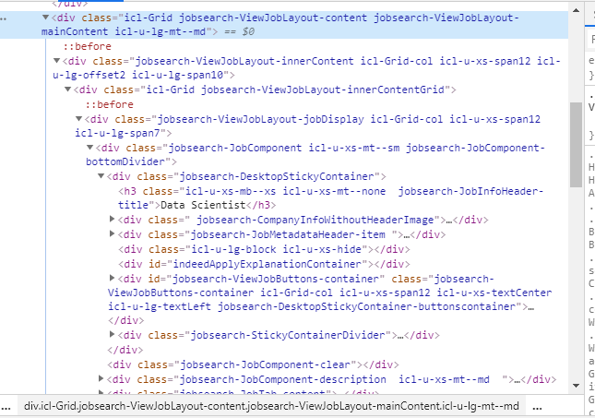

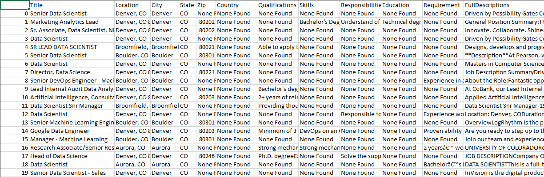
Webscrape 101
Beautiful Soup
Notes:
Jodi – How We solved it – Web Scraping
In order to get job postings off of Indeed.com, we used the python library, Beautiful Soup to scrape the website. Beautiful Soup allowed us to go from this to a nice clean csv export.
Picture credit: https://medium.com/@shivangisareen/beautiful-soup-in-python-79697b33e294

Slide 14

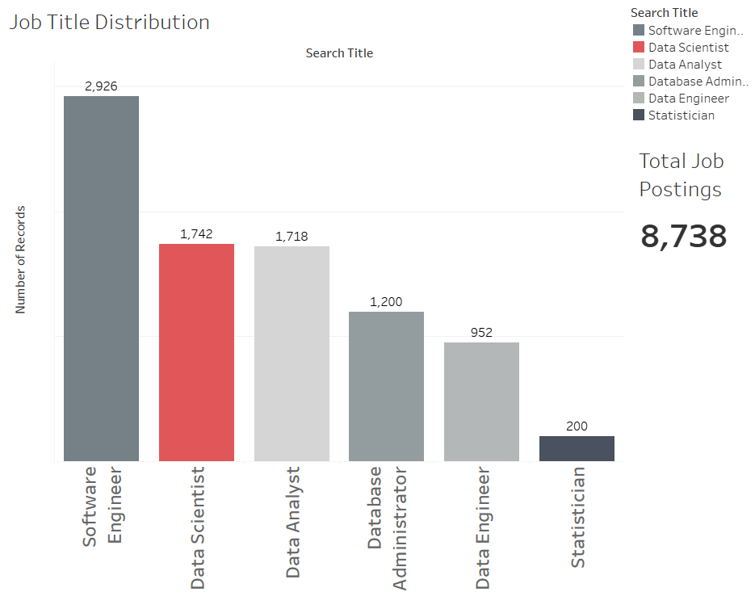
A Total of 8,738 Job Postings were scraped
2,926
1,742
1,718
1,200
952
200
Notes:
Jodi – Process – How we solved it: Collecting Data
Through our webscrape of 16 cities (such as Los Angeles, Seattle, Dallas, Denver, New York City and Washington D.C.) and 6 different job titles, we collected 8,738 job postings.

Slide 15
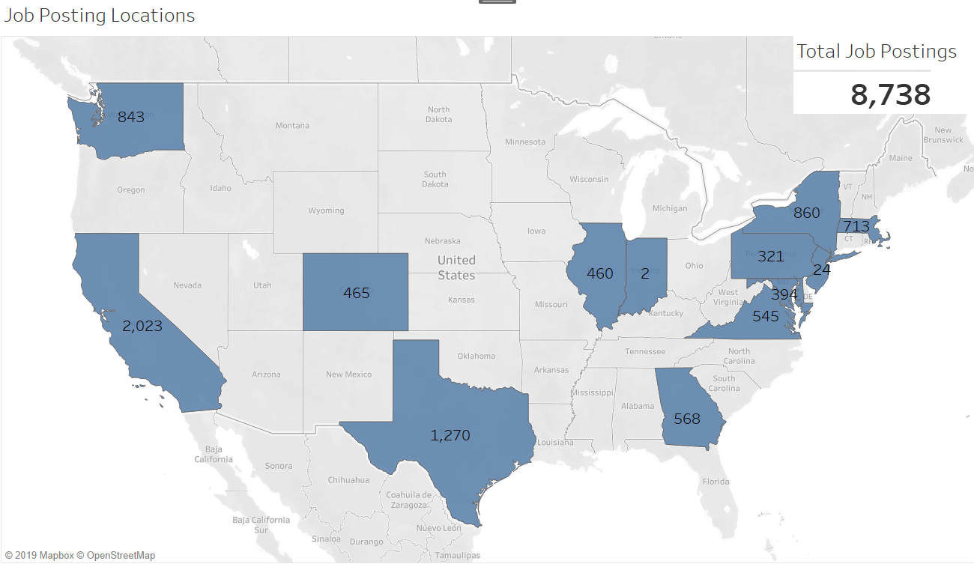
Job Distribution
Notes:
Jodi – EDA – Data Collected: States, number of postings for each title.
West Coast – California
Central – Texas
East Coast – New York

Slide 16
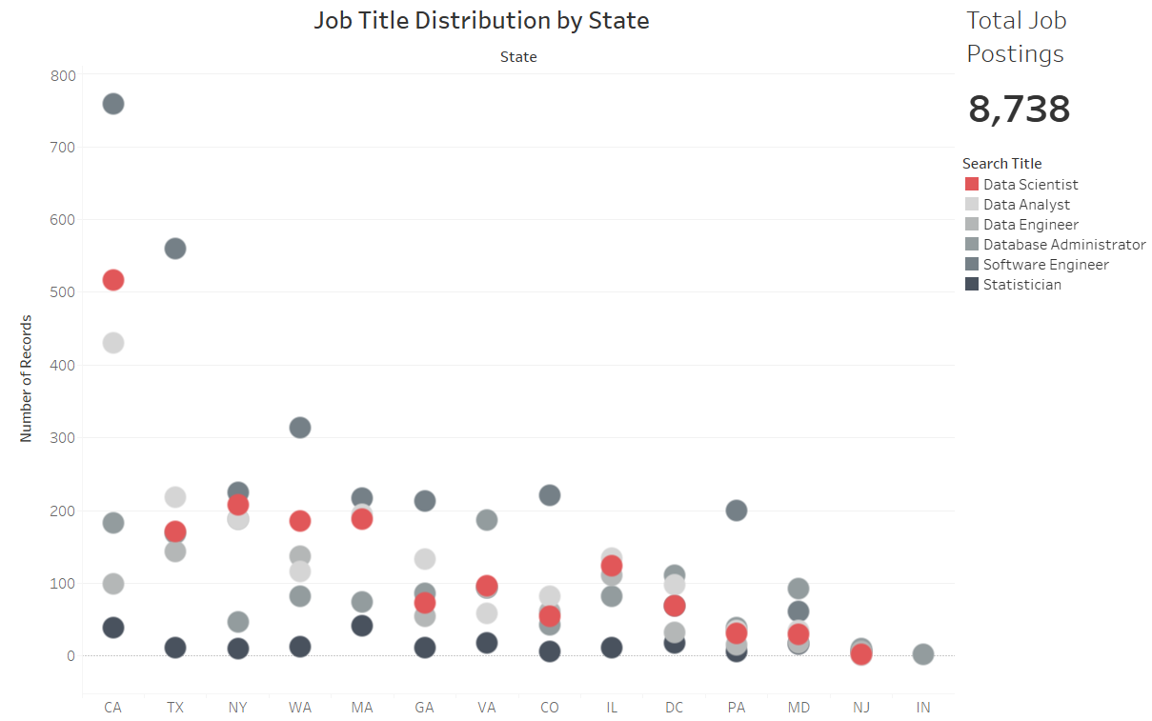
Job Distribution
Will probably change this slide up. Image is too small to be meaningful…..
Notes:
Jodi – EDA
California had the most Data Scientist job posting. Although Texas had more postings collected, New York, Washington state, and Massachusetts had more Data Scientist job postings.

Slide 17
How we solved it: NLP Pipeline
Notes….. Cleaning process brought us to a total of …… job postings. Cleaning process consisted of pulling postings with bullet pointed skills/attributes, removing stopwords, etc.
Notes:
Jodi – Process – How we solved it: NLP Pipeline

Slide 18
How we solved it: NLP Pipeline
Carry-over from previous slide

Slide 19
How we solved it: Universal Sentence Embedder
Notes:
Jodi – Process – How we solved it: Universal Sentence Embedder

Slide 20
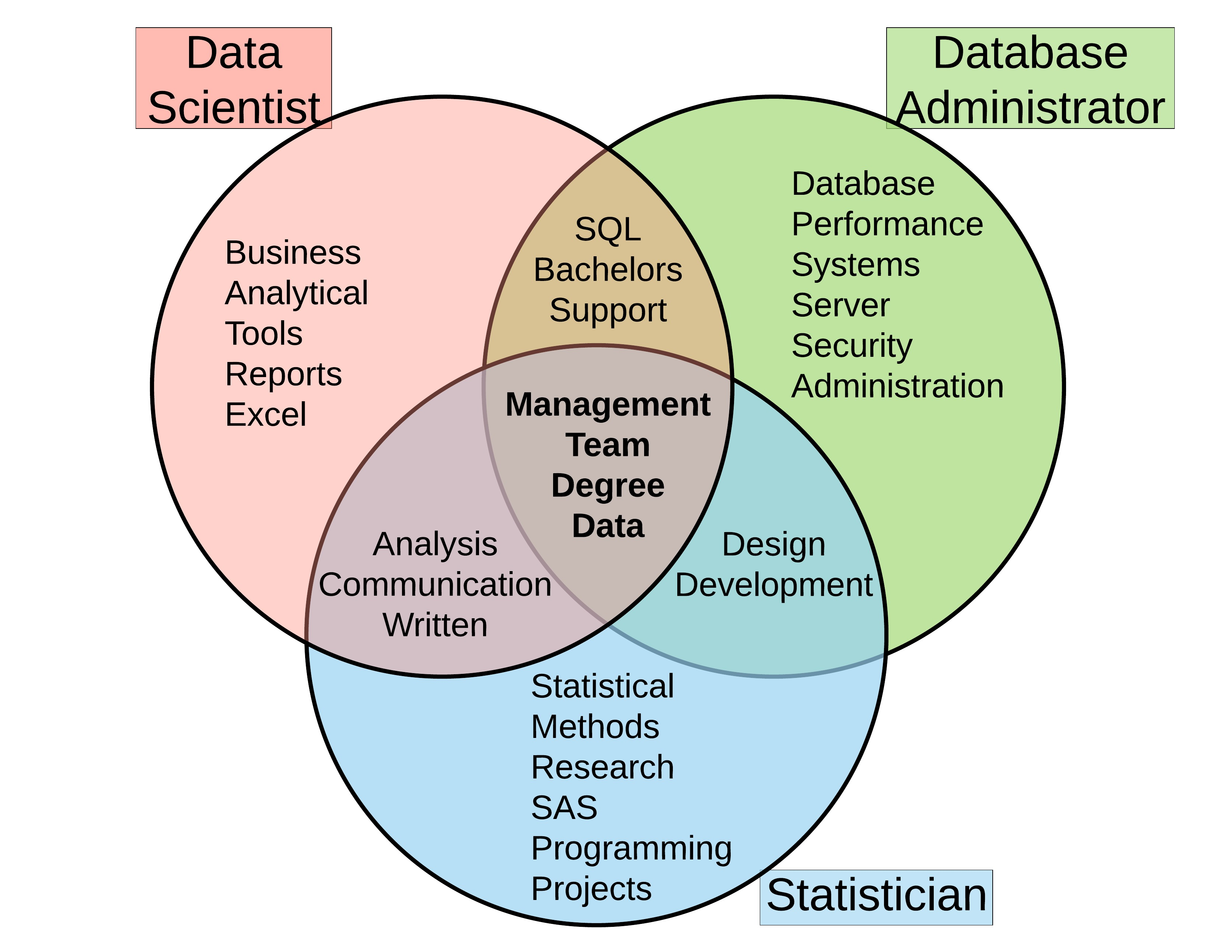
**Add main focus point…
Notes:
Jodi – Display Venn-Diagram

Slide 21
Feature Vector
Notes:
An - Results

Slide 22
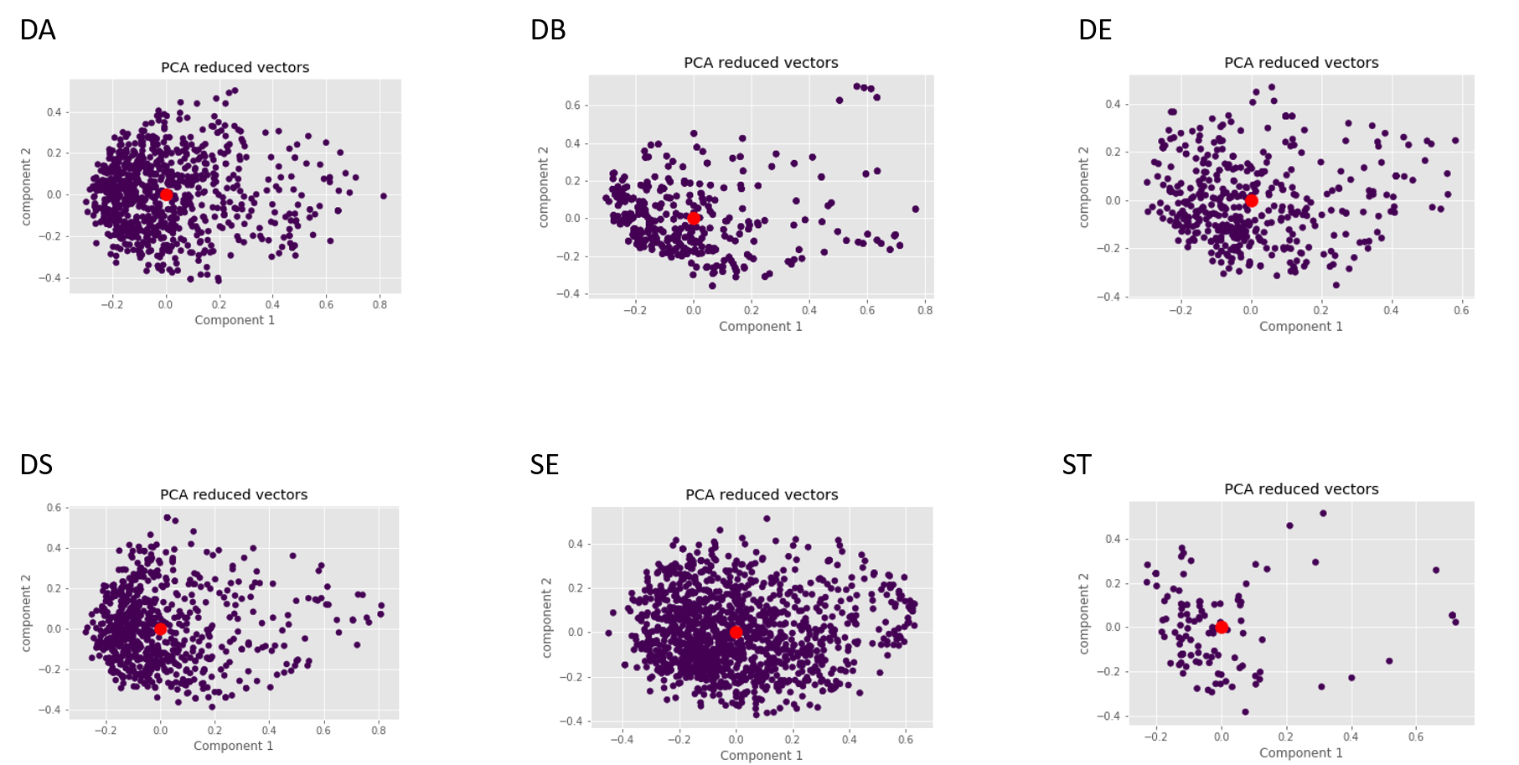
Principal Component Analysis transformation of individual job titles.
Notes:
In order to visualize the job clusters we used PCA to transform the 512 vector into a 2-dimensional space.
DA = Data Analyst
DB = Database Administrator
DE = Data Engineer
DS = Data Scientist
SE = Software Engineer
ST = Statitician

Slide 23
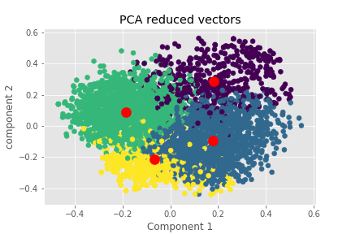
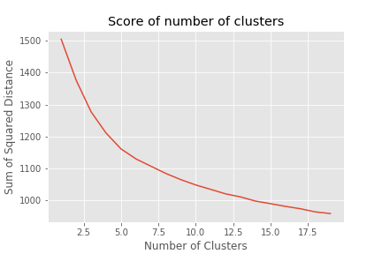
K-Means clustering of combined dataset
Notes:
The vectors are combined into one dataset without labels and passed into an unsupervised clustering algorithm (K-Means). The inertia, sum of squared distance between each point and the cluster center, from different number of clusters is plotted. The elbow in the plot at 4 clusters suggests that according to the algorithm there are 4 different job clusters.

Slide 24
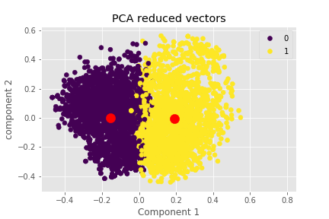
Clustering Supervised
0 Data Scientist
1 Not Data Scientist
Notes:
Labels were then added to the dataset (Data Scientist and Not Data Scientist).
Groups were mapped by finding the greatest number of job titles in each group and normalized by number of jobs scrapped.
Accuracy was ~50%

Slide 25
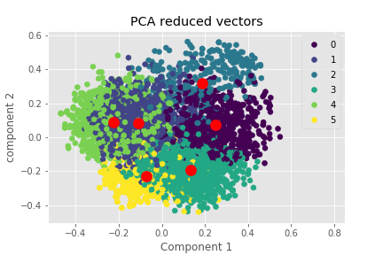
Clustering Supervised
0 Software Engineer
1 Data Scientist
2 Data Analysis
3 Software Engineer
4 Statistician
5 Database Admin
Notes:
Labels of each job titles were added to the data set.
Groups were mapped by finding the greatest number of job titles in each group and normalized by number of jobs scrapped.
Data Engineer was not found by algorithm.
Accuracy was ~50%

Slide 26
Classification
Notes:
An - Results

Slide 27
Classification
Notes:
An - Results

Slide 28
Classification
Notes:
An - Results

Slide 29
Classification
Notes:
An - Results

Slide 30
Model Used to Profile Groups of People
Notes:
Jodi - Ethics

Slide 31
Used to Cheat RTS Systems
Notes:
Jodi - Ethics

Slide 32

One last crowd survey…
Clap if you have a better understanding
DATA SCIENTIST
Notes:
Team – Wrap Up

Slide 33
We’d Love to Hear from You
Andy Ho –
An Nguyen –
Jodi Pafford –
Notes:
Team – Final Slide

